Slide 1
Computer Systems An Integrated Approach to Architecture and Operating Systems
Chapter 9
Memory Hierarchy
©Copyright 2008 Umakishore Ramachandran and William D. Leahy Jr.

Slide 2
9 Memory Hierarchy
Up to now…
Reality…
Processors have cycle times of ~1 ns
Fast DRAM has a cycle time of ~100 ns
We have to bridge this gap for pipelining to be effective!
Black Box
MEMORY

Slide 3
9 Memory Hierarchy
Clearly fast memory is possible
Register files made of flip flops operate at processor speeds
Such memory is Static RAM (SRAM)
Tradeoff
SRAM is fast
Economically unfeasible for large memories

Slide 4
9 Memory Hierarchy
SRAM
High power consumption
Large area on die
Long delays if used for large memories
Costly per bit
DRAM
Low power consumption
Suitable for Large Scale Integration (LSI)
Small size
Ideal for large memories
Circa 2007, a single DRAM chip may contain up to 256 Mbits with an access time of 70 ns.

Slide 5
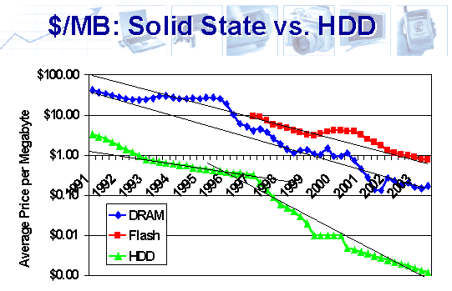
9 Memory Hierarchy
Source: http://www.storagesearch.com/semico-art1.html

Slide 6
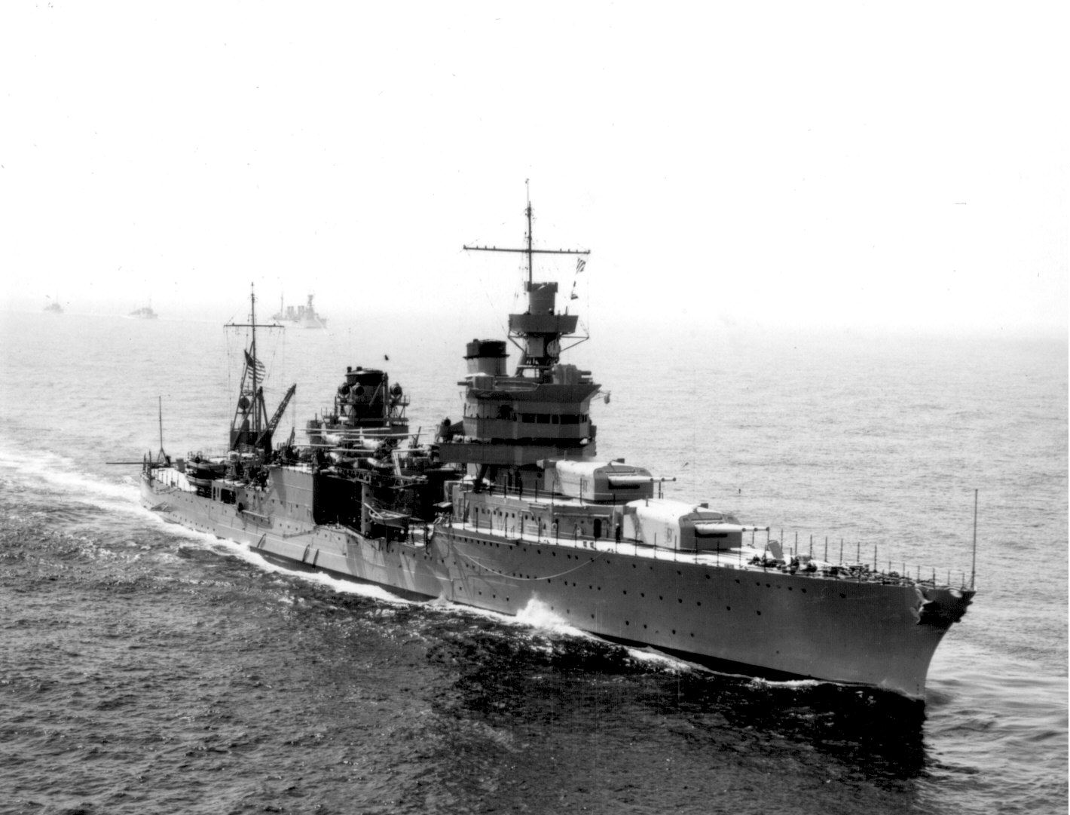

Slide 7
9.1 The Concept of a Cache
Feasible to have small amount of fast memory and/or large amount of slow memory.
Want
Size advantage of DRAM
Speed advantage of SRAM.
Increasing speed as we get closer to the processor
Increasing size as we get farther away from the processor
CPU looks in cache for data it seeks from main memory.
If data not there it retrieves it from main memory.
If the cache is able to service "most" CPU requests then effectively we will get speed advantage of cache.
All addresses in cache are also in memory
CPU
Cache
Main memory

Slide 8
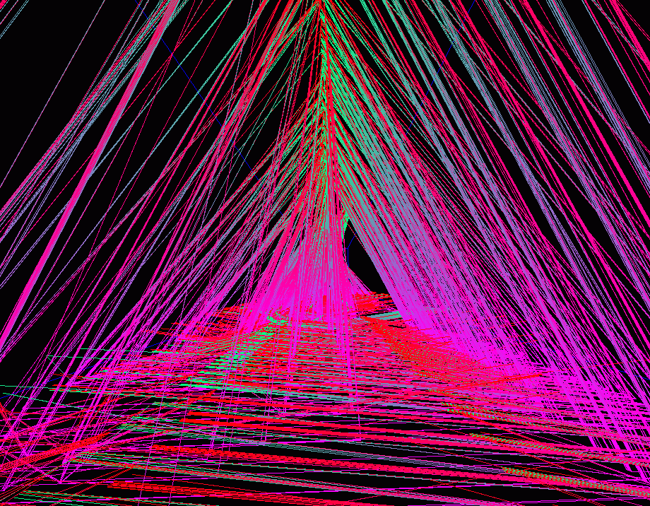
9.2 Principle of Locality

Slide 9
9.2 Principle of Locality
A program tends to access a relatively small region of memory irrespective of its actual memory footprint in any given interval of time. While the region of activity may change over time, such changes are gradual

Slide 10
9.2 Principle of Locality
Spatial Locality: Tendency for locations close to a location that has been accessed to also be accessed
Temporal Locality: Tendency for a location that has been accessed to be accessed again
Example
for(i=0; i<100000; i++)
a[i] = b[i];

Slide 11
9.3 Basic terminologies
Hit: CPU finding contents of memory address in cache
Hit rate (h) is probability of successful lookup in cache by CPU.
Miss: CPU failing to find what it wants in cache (incurs trip to deeper levels of memory hierarchy
Miss rate (m) is probability of missing in cache and is equal to 1-h.
Miss penalty: Time penalty associated with servicing a miss at any particular level of memory hierarchy
Effective Memory Access Time (EMAT): Effective access time experienced by the CPU when accessing memory.
Time to lookup cache to see if memory location is already there
Upon cache miss, time to go to deeper levels of memory hierarchy
EMAT = Tc + m * Tm
where m is cache miss rate, Tc the cache access time and Tm the miss penalty

Slide 12
9.4 Multilevel Memory Hierarchy
Modern processors use multiple levels of caches.
As we move away from processor, caches get larger and slower
EMAT_{i} = T_{i} + m_{i} * EMAT_{i+1}
where T_{i} is access time for level i
and m_{i} is miss rate for level i

Slide 13
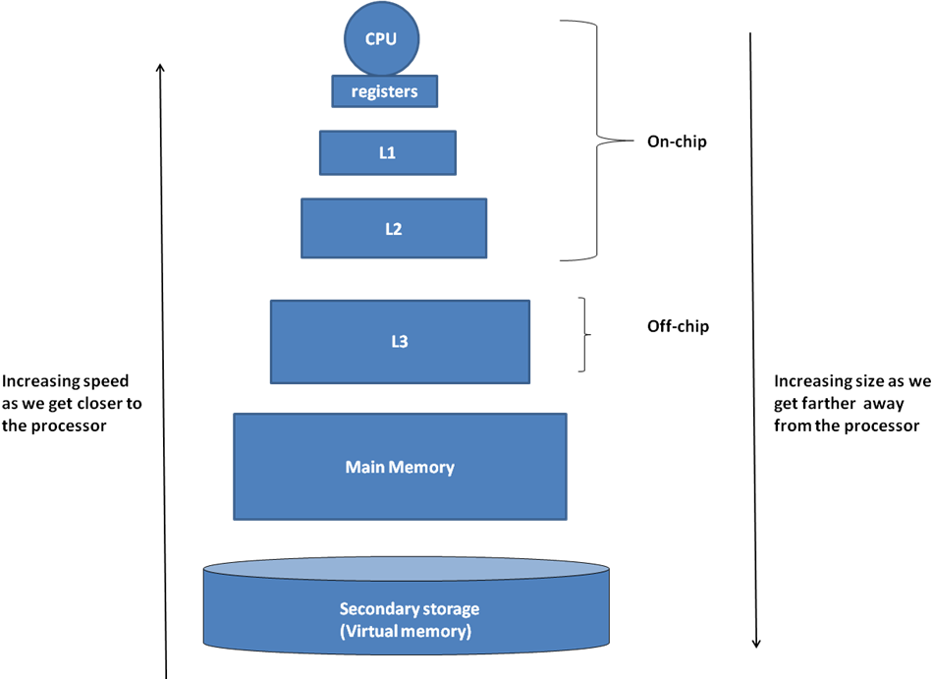
9.4 Multilevel Memory Hierarchy

Slide 14
9.5 Cache organization
There are three facets to the organization of the cache:
Placement: Where do we place in the cache the data read from the memory?
Algorithm for lookup: How do we find something that we have placed in the cache?
Validity: How do we know if the data in the cache is valid?

Slide 15
9.6 Direct-mapped cache organization
0
1
Cache
2
3
0
4
1
5
2
6
3
7
4
8
5
9
6
10
7
11
12
13
14
15

Slide 16
9.6 Direct-mapped cache organization
0
1
2
3
4
5
6
0
8
16
24
7
1
9
17
25
2
10
18
26
3
11
19
27
4
12
20
28
5
13
21
29
6
14
22
30
7
15
23
31

Slide 17
9.6 Direct-mapped cache organization
000
001
010
011
100
101
110
00000
01000
10000
11000
111
00001
01001
10001
11001
00010
01010
10010
11010
00011
01011
10011
11011
00100
01100
10100
11100
00101
01101
10101
11101
00110
01110
10110
11110
00111
01111
10111
11111

Slide 18
9.6.1 Cache Lookup
000
001
010
Cache_Index = Memory_Address mod Cache_Size
011
100
101
110
00000
01000
10000
11000
111
00001
01001
10001
11001
00010
01010
10010
11010
00011
01011
10011
11011
00100
01100
10100
11100
00101
01101
10101
11101
00110
01110
10110
11110
00111
01111
10111
11111

Slide 19
9.6.1 Cache Lookup
Tag
Contents
000
00
001
00
010
00
Cache_Index = Memory_Address mod Cache_Size
Cache_Tag = Memory_Address/Cache_Size
011
00
100
00
101
00
110
00
00000
01000
10000
11000
111
00
00001
01001
10001
11001
00010
01010
10010
11010
00011
01011
10011
11011
00100
01100
10100
11100
00101
01101
10101
11101
00110
01110
10110
11110
00111
01111
10111
11111

Slide 20
9.6.1 Cache Lookup
Keeping it real!
Assume
4Gb Memory: 32 bit address
256 Kb Cache
Cache is organized by words
1 Gword memory
64 Kword cache ➔ 16 bit cache index
Memory Address
Breakdown
Tag
00000000000000
Index
0000000000000000
Byte Offset
00
Cache
Line
Index
0000000000000000
Tag
00000000000000
Contents
00000000000000000000000000000000

Slide 21
Sequence of Operation
Processor emits 32 bit address to cache
Tag
10101010101010
Index
0000000000000010
Byte Offset
00
Index
0000000000000000
Tag
00000000000000
Contents
00000000000000000000000000000000
Index
0000000000000001
Tag
00000000000000
Contents
00000000000000000000000000000000
Index
0000000000000010
Tag
10101010101010
Contents
00000000000000000000000000000000
Index
1111111111111111
Tag
00000000000000
Contents
00000000000000000000000000000000

Slide 22
Thought Question
Assume computer is turned on and every location in cache is zero. What can go wrong?
Processor emits 32 bit address to cache
Tag
00000000000000
Index
0000000000000010
Byte Offset
00
Index
0000000000000000
Tag
00000000000000
Contents
00000000000000000000000000000000
Index
0000000000000001
Tag
00000000000000
Contents
00000000000000000000000000000000
Index
0000000000000010
Tag
00000000000000
Contents
00000000000000000000000000000000
Index
1111111111111111
Tag
00000000000000
Contents
00000000000000000000000000000000

Slide 23
Add a Bit!
Each cache entry contains a bit indicating if the line is valid or not. Initialized to invalid
Processor emits 32 bit address to cache
Tag
00000000000000
Index
0000000000000010
Byte Offset
00
Index
0000000000000000
V
0
Tag
00000000000000
Contents
00000000000000000000000000000000
Index
0000000000000001
V
0
Tag
00000000000000
Contents
00000000000000000000000000000000
Index
0000000000000010
V
0
Tag
00000000000000
Contents
00000000000000000000000000000000
Index
1111111111111111
V
0
Tag
00000000000000
Contents
00000000000000000000000000000000

Slide 24
9.6.2 Fields of a Cache Entry
Is the sequence of fields significant?
Would this work?
Tag
00000000000000
Index
0000000000000000
Byte Offset
00
Index
0000000000000000
Tag
00000000000000
Byte Offset
00

Slide 25
9.6.3 Hardware for direct mapped cache
Memory address
Cache Tag
Valid
Tag
Data
Cache Index
.
.
.
.
.
.
Data
To
CPU
=
hit
y

Slide 26
Question
Does the caching concept described so far exploit
Temporal locality
Spatial locality
Working set

Slide 27
9.7 Repercussion on pipelined processor design
IF
ID/RR
EXEC
MEM
WB
B
U
F
F
E
R
B
U
F
F
E
R
B
U
F
F
E
R
B
U
F
F
E
R
PC
DPRF
ALU-1
I-Cache
D-Cache
data
A
B
ALU-2
Decode
logic
DPRF
ALU
Miss on I-Cache: Insert bubbles until contents supplied
Miss on D-Cache: Insert bubbles into WB stall IF, ID/RR, EXEC

Slide 28
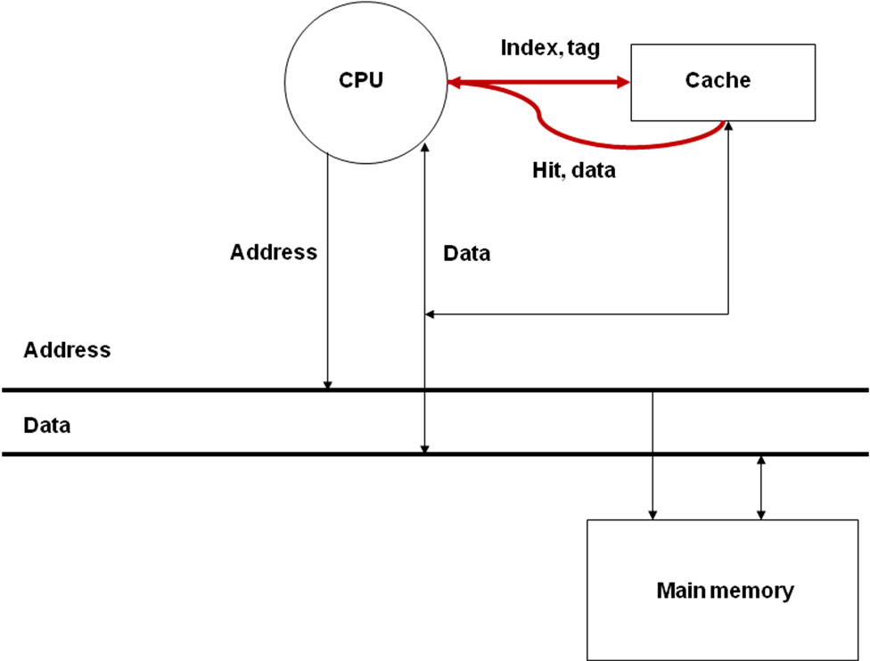
9.8 Cache read/write algorithms
Read Hit

Slide 29
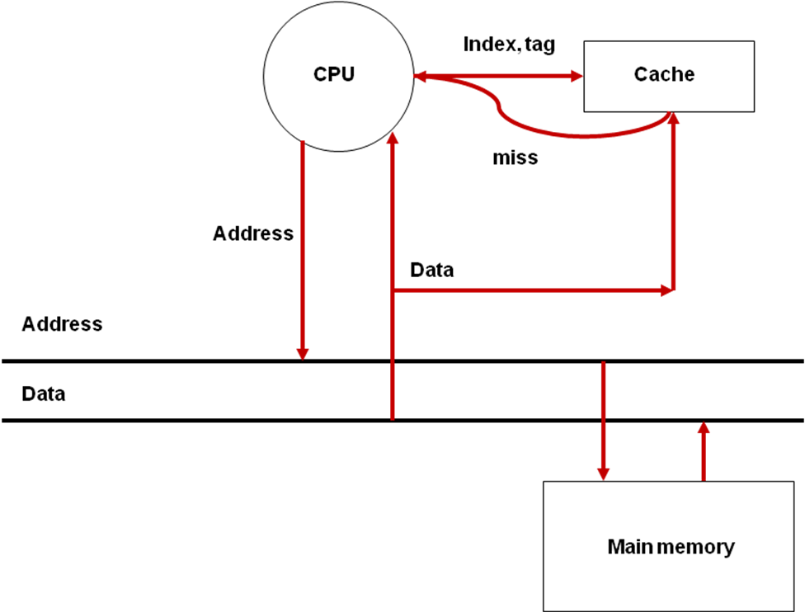
9.8 Basic cache read/write algorithms
Read Miss

Slide 30
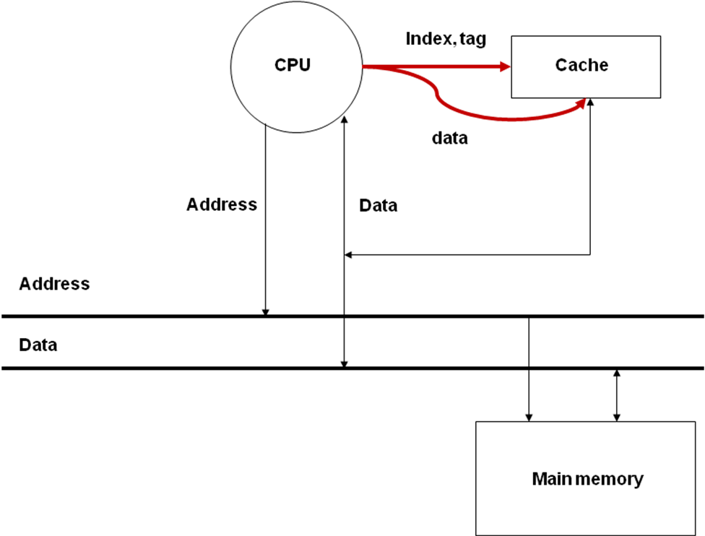
9.8 Basic cache read/write algorithms
Write-Back

Slide 31
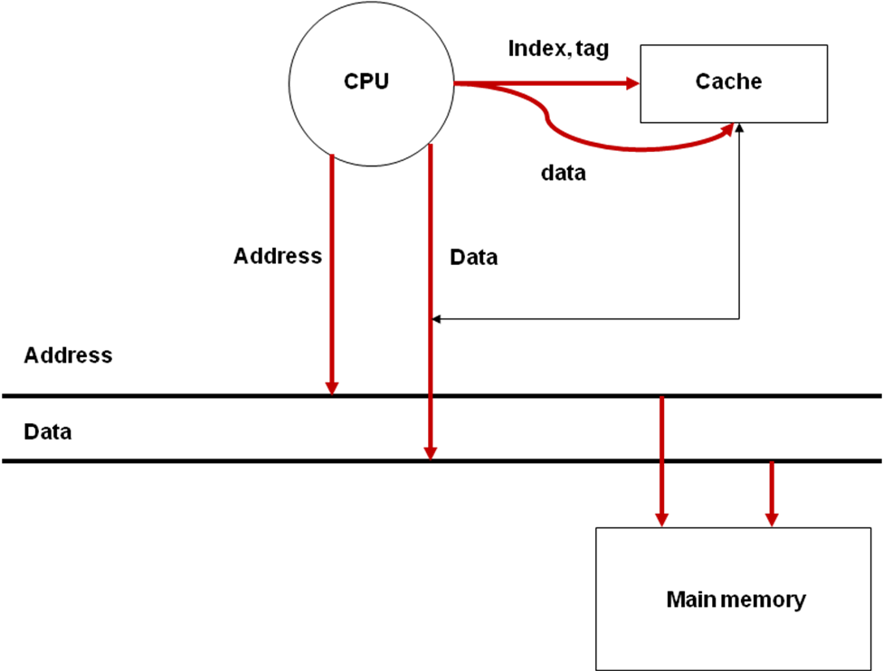
9.8 Basic cache read/write algorithms
Write-Through

Slide 32
9.8.1 Read Access to Cache from CPU
CPU sends index to cache. Cache looks iy up and if a hit sends data to CPU. If cache says miss CPU sends request to main memory. All in same cycle (IF or MEM in pipeline)
Upon sending address to memory CPU sends NOP's down to subsequent stage until data read. When data arrives it goes to CPU and the cache.

Slide 33
9.8.2 Write Access to Cache from CPU
Two choices
Write through policy
Write allocate
No-write allocate
Write back policy

Slide 34
9.8.2.1 Write Through Policy
Each write goes to cache. Tag is set and valid bit is set
Each write also goes to write buffer (see next slide)

Slide 35
9.8.2.1 Write Through Policy
CPU
Address
Data
Address
Data
Address
Data
Write Buffer
Address
Data
Address
Address
Data
Data
Main memory
Write-Buffer for Write-Through Efficiency

Slide 36
9.8.2.1 Write Through Policy
Each write goes to cache. Tag is set and valid bit is set
This is write allocate
There is also a no-write allocate where the cache is not written to if there was a write miss
Each write also goes to write buffer
Write buffer writes data into main memory
Will stall if write buffer full

Slide 37
9.8.2.2 Write back policy
CPU writes data to cache setting dirty bit
Note: Cache and memory are now inconsistent but the dirty bit tells us that

Slide 38
9.8.2.2 Write back policy
We write to the cache
We don't bother to update main memory
Is the cache consistent with main memory?
Is this a problem?
Will we ever have to write to main memory?

Slide 39
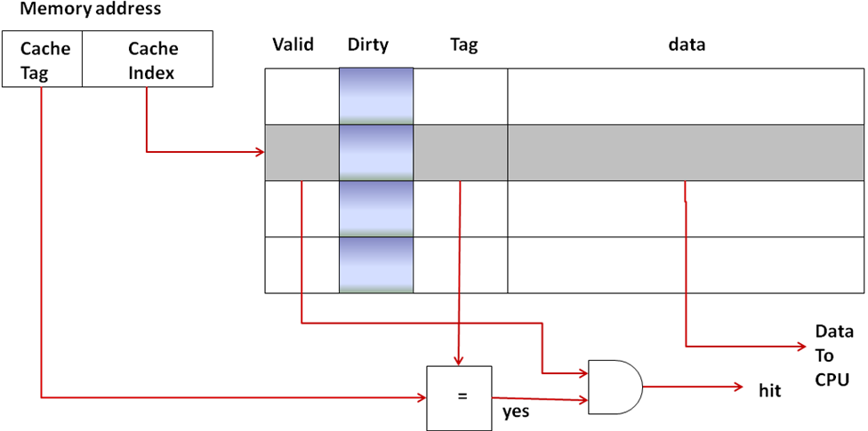
9.8.2.2 Write back policy

Slide 40
9.8.2.3 Comparison of the Write Policies
Write Through
Cache logic simpler and faster
Creates more bus traffic
Write back
Requires dirty bit and extra logic
Multilevel cache processors may use both
L1 Write through
L2/L3 Write back

Slide 41
9.9 Dealing with cache misses in the processor pipeline
Read miss in the MEM stage:
I1: ld r1, a ; r1 <- MEM[a]
I2: add r3, r4, r5 ; r3 <- r4 + r5
I3: and r6, r7, r8 ; r6 <- r7 AND r8
I4: add r2, r4, r5 ; r2 <- r4 + r5
I5: add r2, r1, r2 ; r2 <- r1 + r2
Write miss in the MEM stage: The write-buffer alleviates the ill effects of write misses in the MEM stage. (Write-Through)

Slide 42
9.9.1 Effect of Memory Stalls Due to Cache Misses on Pipeline Performance
ExecutionTime = NumberInstructionsExecuted * CPI_{Avg} * clock cycle time
ExecutionTime = (NumberInstructionsExecuted * (CPI_{Avg} + MemoryStalls_{Avg}) ) * clock cycle time
EffectiveCPI = CPI_{Avg} + MemoryStalls_{Avg}
TotalMemory Stalls = NumberInstructions * MemoryStalls_{Avg}
MemoryStalls_{Avg} = MissesPerInstruction_{Avg} * MissPenalty_{Avg}

Slide 43
9.9.1 Improving cache performance
Consider a pipelined processor that has an average CPI of 1.8 without accounting for memory stalls. I-Cache has a hit rate of 95% and the D-Cache has a hit rate of 98%. Assume that memory reference instructions account for 30% of all the instructions executed. Out of these 80% are loads and 20% are stores. On average, the read-miss penalty is 20 cycles and the write-miss penalty is 5 cycles. Compute the effective CPI of the processor accounting for the memory stalls.

Slide 44
9.9.1 Improving cache performance
Cost of instruction misses = I-cache miss rate * read miss penalty
= (1 - 0.95) * 20
= 1 cycle per instruction
Cost of data read misses = fraction of memory reference instructions in program *
fraction of memory reference instructions that are loads *
D-cache miss rate * read miss penalty
= 0.3 * 0.8 * (1 – 0.98) * 20
= 0.096 cycles per instruction
Cost of data write misses = fraction of memory reference instructions in the program *
fraction of memory reference instructions that are stores *
D-cache miss rate * write miss penalty
= 0.3 * 0.2 * (1 – 0.98) * 5
= 0.006 cycles per instruction
Effective CPI = base CPI + Effect of I-Cache on CPI + Effect of D-Cache on CPI
= 1.8 + 1 + 0.096 + 0.006 = 2.902

Slide 45
9.9.1 Improving cache performance
Bottom line…Improving miss rate and reducing miss penalty are keys to improving performance

Slide 46
9.10 Exploiting spatial locality to improve cache performance
So far our cache designs have been operating on data items the size typically handled by the instruction set e.g. 32 bit words. This is known as the unit of memory access
But the size of the unit of memory transfer moved by the memory subsystem does not have to be the same size
Typically we can make memory transfer something that is bigger and is a multiple of the unit of memory access

Slide 47
9.10 Exploiting spatial locality to improve cache performance
For example
Our cache blocks are 16 bytes long
How would this affect our earlier example?
4Gb Memory: 32 bit address
256 Kb Cache
Word
Word
Word
Word
Byte
Byte
Byte
Byte
Byte
Byte
Byte
Byte
Byte
Byte
Byte
Byte
Byte
Byte
Byte
Byte
Cache Block

Slide 48
9.10 Exploiting spatial locality to improve cache performance
Block size 16 bytes
4Gb Memory: 32 bit address
256 Kb Cache
Total blocks = 256 Kb/16 b = 16K Blocks
Need 14 bits to index block
How many bits for block offset?
Word
Word
Word
Word
Byte
Byte
Byte
Byte
Byte
Byte
Byte
Byte
Byte
Byte
Byte
Byte
Byte
Byte
Byte
Byte
Cache Block

Slide 49
9.10 Exploiting spatial locality to improve cache performance
Block size 16 bytes
4Gb Memory: 32 bit address
256 Kb Cache
Total blocks = 256 Kb/16 b = 16K Blocks
Need 14 bits to index block
How many bits for block offset?
16 bytes (4 words) so 4 (2) bits
Byte Offset
Word Offset
Tag
14 bits
00000000000000
Block Index
14 bits
00000000000000
Block
Offset
0000
Tag
14 bits
00000000000000
Block Index
14 bits
00000000000000
00
00

Slide 50
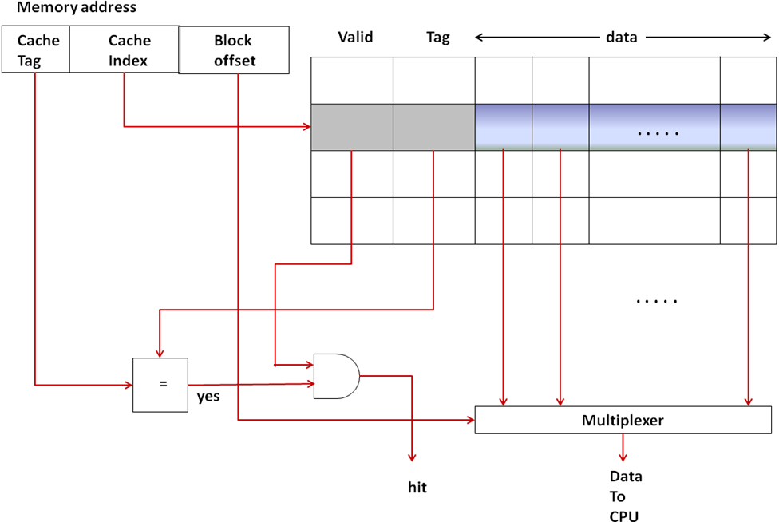
9.10 Exploiting spatial locality to improve cache performance

Slide 51
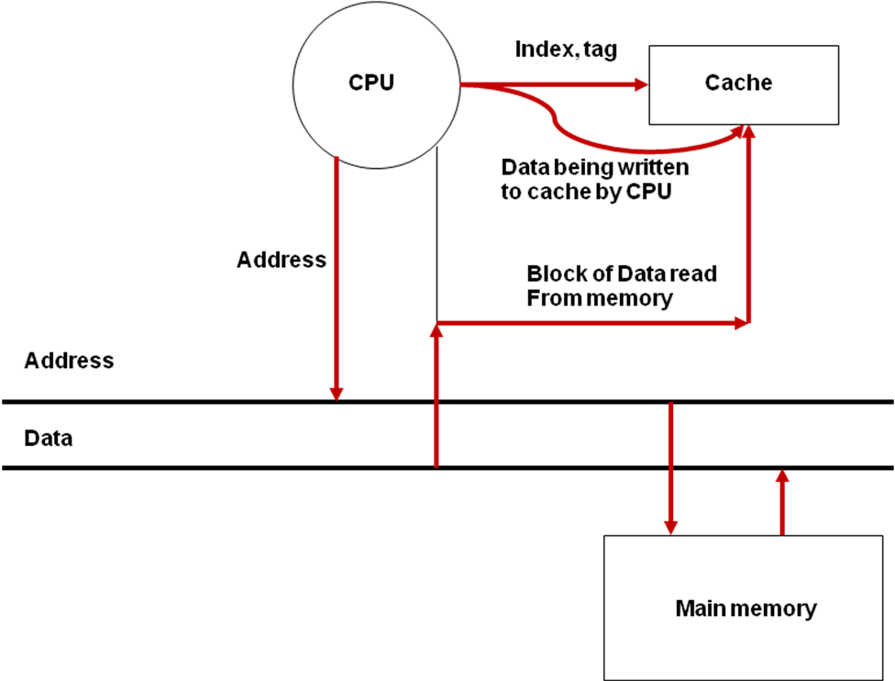
9.10 Exploiting spatial locality to improve cache performance
CPU, cache, and memory interactions for handling a write-miss

Slide 52
N.B. Each block regardless of length
has one tag and one valid bit
Dirty bits may
or may not be the same story!

Slide 53
9.10.1 Performance implications of increased blocksize
We would expect that increasing the block size will lower the miss rate.
Should we keep on increasing block up to the limit of 1 block per cache!?!?!?

Slide 54
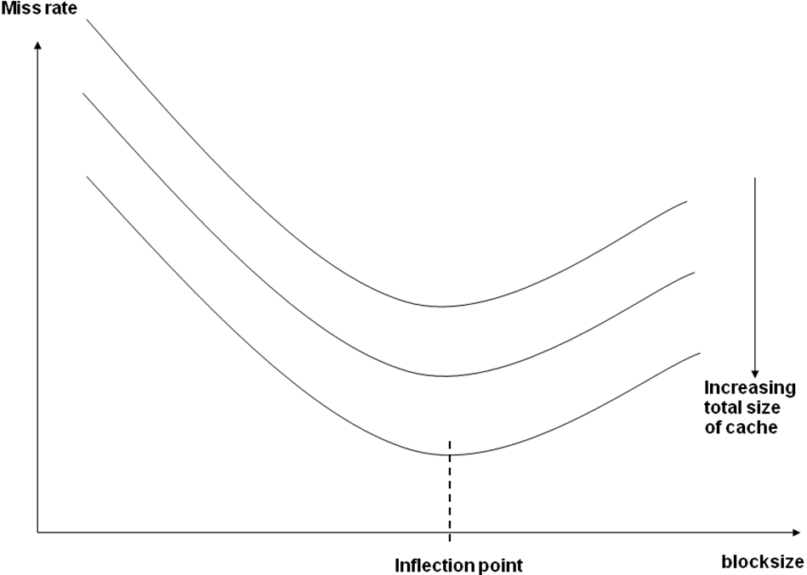
9.10.1 Performance implications of increased blocksize
No, as the working set changes
over time a bigger block size
will cause a loss of efficiency

Slide 55
Question
Does the multiword block concept just described exploit
Temporal locality
Spatial locality
Working set

Slide 56
9.11 Flexible placement
Imagine two areas of your current working set map to the same area in cache.
There is plenty of room in the cache…you just got unlucky
Imagine you have a working set which is less than a third of your cache. You switch to a different working set which is also less than a third but maps to the same area in the cache. It happens a third time.
The cache is big enough…you just got unlucky!

Slide 57
9.11 Flexible placement
WS 1
Unused
WS 2
Cache
WS 3
Memory footprint of a program

Slide 58
9.11 Flexible placement
What is causing the problem is not your luck
It's the direct mapped design which only allows one place in the cache for a given address
What we need are some more choices!
Can we imagine designs that would do just that?

Slide 59
9.11.1 Fully associative cache
As before the cache is broken up into blocks
But now a memory reference may appear in any block
How many bits for the index?
How many for the tag?

Slide 60
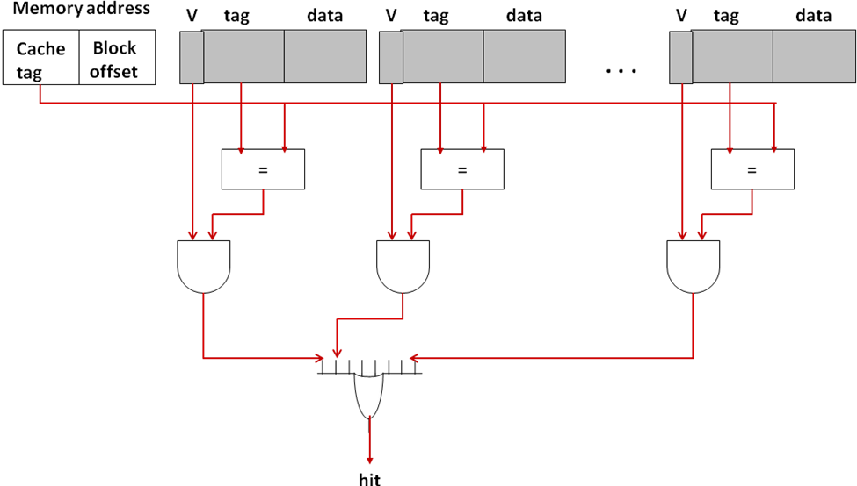
9.11.1 Fully associative cache

Slide 61
9.11.2 Set associative caches
VTag
Data
VTag
Data
Two-way Set
Associative
VTag
Data
VTag
Data
VTag
Data
VTag
Data
VTag
Data
VTag
Data
VTag
Data
VTag
Data
Four-way Set
Associative
VTag
Data
VTag
Data
VTag
Data
VTag
Data
VTag
Data
VTag
Data
Direct
Mapped
(1-way)
VTag
Data
VTag
Data
VTag
Data
VTag
Data
VTag
Data
VTag
Data
VTag
Data
VTag
Data
Fully
Associative
(8-way)
VTag
Data
VTag
Data
VTag
Data
VTag
Data
VTag
Data
VTag
Data
VTag
Data
VTag
Data

Slide 62
9.11.2 Set associative caches
Assume we have a computer with 16 bit addresses and 64 Kb of memory
Further assume cache blocks are 16 bytes long and we have 128 bytes available
for cache data
Cache Type | Cache Lines | Ways | Tag | Index bits | Block Offset (bits)
Direct Mapped | 8 | 1 | 9 | 3 | 4
Two-way Set Associative | 4 | 2 | 10 | 2 | 4
Four-way Set Associative | 2 | 4 | 11 | 1 | 4
Fully Associative | 1 | 8 | 12 | 0 | 4

Slide 63
9.11.2 Set associative caches

Slide 64
9.11.3 Extremes of set associativity
Two-way Set
Associative
2 Ways
Direct
Mapped
(1-way)
1-Way
VTag
Data
VTag
Data
VTag
Data
4 sets
VTag
Data
VTag
Data
VTag
Data
VTag
Data
VTag
Data
VTag
Data
VTag
Data
VTag
Data
8 sets
VTag
Data
VTag
Data
4 Ways
VTag
Data
Four-way Set
Associative
VTag
Data
VTag
Data
2 sets
VTag
Data
VTag
Data
VTag
Data
VTag
Data
VTag
Data
VTag
Data
VTag
Data
VTag
Data
Fully
Associative
(8-way)
8 Ways
1 set
VTag
Data
VTag
Data
VTag
Data
VTag
Data
VTag
Data
VTag
Data
VTag
Data
VTag
Data

Slide 65
9.12 Instruction and Data caches
Would it be better to have two separate caches or just one larger cache with a lower miss rate?
Roughly 30% of instructions are Load/Store requiring two simultaneous memory accesses
The contention caused by combining caches would cause more problems than it would solve by lowering miss rate

Slide 66
9.13 Reducing miss penalty
Reducing the miss penalty is desirable
It cannot be reduced enough just by making the block size larger due to diminishing returns
Bus Cycle Time: Time for each data transfer between memory and processor
Memory Bandwidth: Amount of data transferred in each cycle between memory and processor

Slide 67
9.14 Cache replacement policy
An LRU policy is best when deciding which of the multiple "ways" to evict upon a cache miss
Type Cache | Bits to record LRU
Direct Mapped | N/A
2-Way | 1 bit/line
4-Way | ? bits/line

Slide 68
9.15 Recapping Types of Misses
Compulsory: Occur when program accesses memory location for first time. Sometimes called cold misses
Capacity: Cache is full and satisfying request will require some other line to be evicted
Conflict: Cache is not full but algorithm sends us to a line that is full
Fully associative cache can only have compulsory and capacity
Compulsory>Capacity>Conflict

Slide 69
9.16 Integrating TLB and Caches
CPU
VA
PA
Instruction or
Data
TLB
Cache

Slide 70
9.17 Cache controller
Upon request from processor, looks up cache to determine hit or miss, serving data up to processor in case of hit.
Upon miss, initiates bus transaction to read missing block from deeper levels of memory hierarchy.
Depending on details of memory bus, requested data block may arrive asynchronously with respect to request. In this case, cache controller receives block and places it in appropriate spot in cache.
Provides ability for the processor to specify certain regions of memory as “uncachable.”

Slide 71
9.18 Virtually Indexed Physically Tagged Cache
VPN
Page offset
Index
Cache
TLB
PFN
Tag
Data
=?
Hit

Slide 72
9.19 Recap of Cache Design Considerations
Principles of spatial and temporal locality
Hit, miss, hit rate, miss rate, cycle time, hit time, miss penalty
Multilevel caches and design considerations thereof
Direct mapped caches
Cache read/write algorithms
Spatial locality and blocksize
Fully- and set-associative caches
Considerations for I- and D-caches
Cache replacement policy
Types of misses
TLB and caches
Cache controller
Virtually indexed physically tagged caches

Slide 73
9.20 Main memory design considerations
A detailed analysis of a modern processors memory system is beyond the scope of the book
However, we present some concepts to illustrate some of the types of designs one might find in practice

Slide 74
9.20.1 Simple main memory
CPU
Cache
Address
Data
Address (32 bits)
Data (32 bits)
Main memory
(32 bits wide)

Slide 75
9.20.2 Main memory and bus to match cache block size
CPU
Cache
Address
Data
Address (32 bits)
Data (128 bits)
Main memory
(128 bits wide)

Slide 76
9.20.3 Interleaved memory
Data
(32 bits)
Memory Bank M0
(32 bits wide)
Memory Bank M1
(32 bits wide)
Block
Address
CPU
(32 bits)
Memory Bank M2
(32 bits wide)
Cache
Memory Bank M3
(32 bits wide)

Slide 77
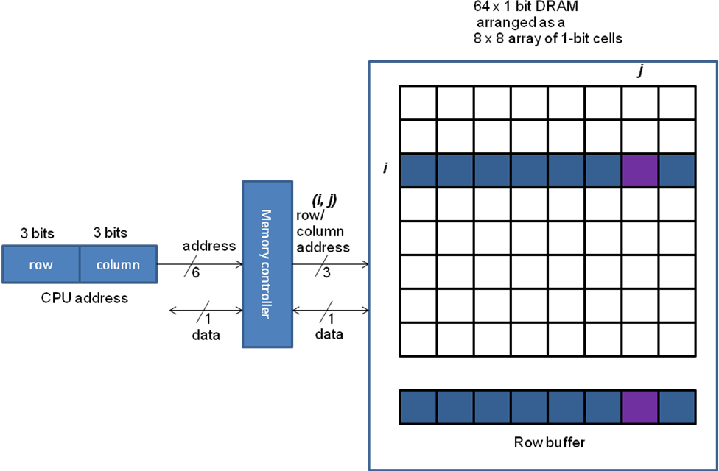
9.21 Elements of a modern main memory systems

Slide 78
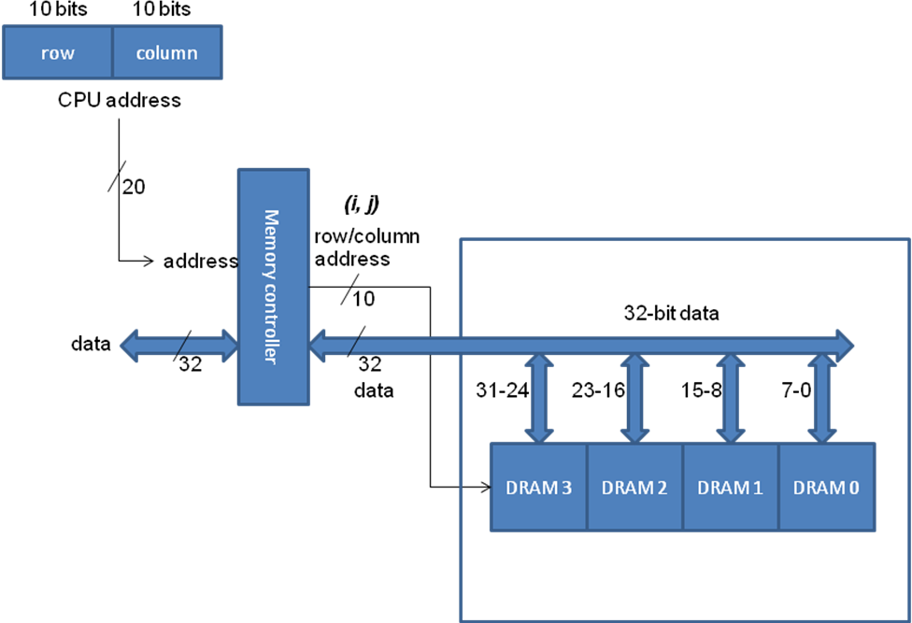
9.21 Elements of a modern main memory systems

Slide 79
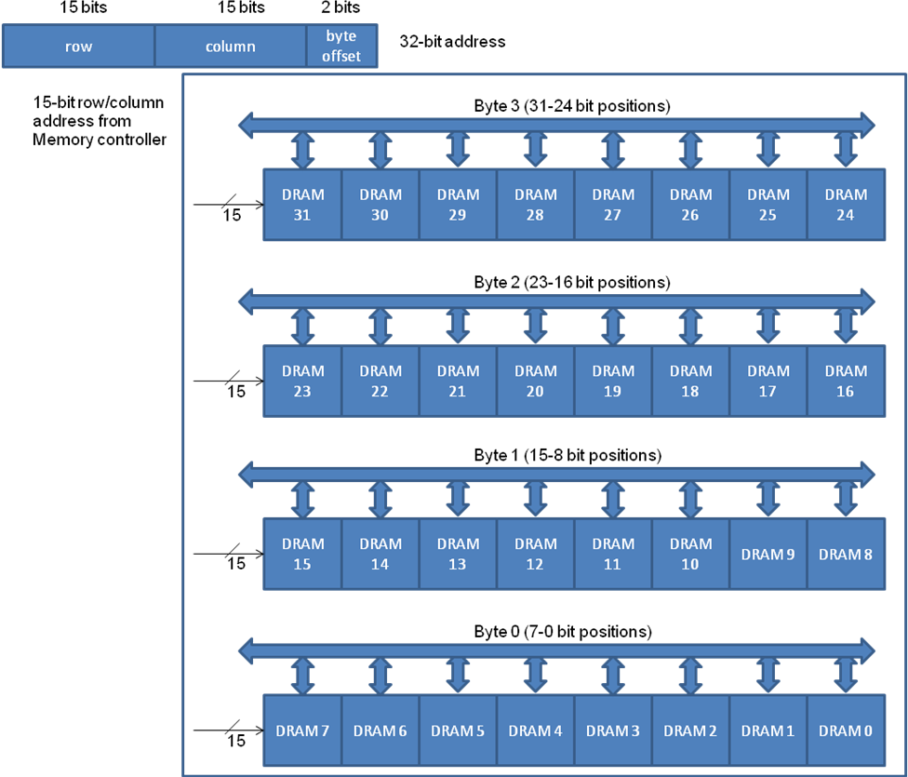
9.21 Elements of a modern main memory systems

Slide 80
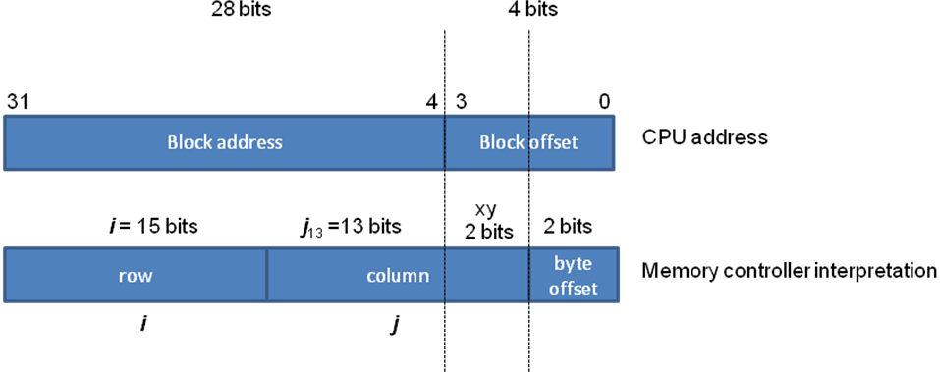
9.21.1 Page Mode DRAM

Slide 81
9.22 Performance implications of memory hierarchy
Type of Memory | Typical Size | Approximate latency in CPU clock cycles to read one word of 4 bytes
CPU registers | 8 to 32 | Usually immediate access (0-1 clock cycles)
L1 Cache | 32 (Kilobyte) KB to 128 KB | 3 clock cycles
L2 Cache | 128 KB to 4 Megabyte (MB) | 10 clock cycles
Main (Physical) Memory | 256 MB to 4 Gigabyte (GB) | 100 clock cycles
Virtual Memory (on disk) | 1 GB to 1 Terabyte (TB) | 1000 to 10,000 clock cycles (not accounting for the software overhead of handling page faults)

Slide 82
9.23 Summary
Category | Vocabulary | Details
Principle of locality (Section 9.2) | Spatial | Access to contiguous memory locations
 | Temporal | Reuse of memory locations already accessed
Cache organization | Direct-mapped | One-to-one mapping (Section 9.6)
 | Fully associative | One-to-any mapping (Section 9.12.1)
 | Set associative | One-to-many mapping (Section 9.12.2)
Cache reading/writing (Section 9.8) | Read hit/Write hit | Memory location being accessed by the CPU is present in the cache
 | Read miss/Write miss | Memory location being accessed by the CPU is not present in the cache
Cache write policy (Section 9.8) | Write through | CPU writes to cache and memory
 | Write back | CPU only writes to cache; memory updated on replacement

Slide 83
9.23 Summary
Category | Vocabulary | Details
Cache parameters | Total cache size (S) | Total data size of cache in bytes
 | Block Size (B) | Size of contiguous data in one data block
 | Degree of associativity (p) | Number of homes a given memory block can reside in a cache
 | Number of cache lines (L) | S/pB
 | Cache access time | Time in CPU clock cycles to check hit/miss in cache
 | Unit of CPU access | Size of data exchange between CPU and cache
 | Unit of memory transfer | Size of data exchange between cache and memory
 | Miss penalty | Time in CPU clock cycles to handle a cache miss
Memory address interpretation | Index (n) | log₂L bits, used to look up a particular cache line
 | Block offset (b) | log₂B bits, used to select a specific byte within a block
 | Tag (t) | a – (n+b) bits, where a is number of bits in memory address; used for matching with tag stored in the cache

Slide 84
9.23 Summary
Category | Vocabulary | Details
Cache entry/cache block/cache line/set | Valid bit | Signifies data block is valid
 | Dirty bits | For write-back, signifies if the data block is more up to date than memory
 | Tag | Used for tag matching with memory address for hit/miss
 | Data | Actual data block
Performance metrics | Hit rate (h) | Percentage of CPU accesses served from the cache
 | Miss rate (m) | 1 – h
 | Avg. Memory stall | Misses-per-instruction_{Avg} * miss-penalty_{Avg}
 | Effective memory access time (EMAT_{i}) at level i | EMAT_{i} = T_{i} + m_{i} * EMAT_{i+1}
 | Effective CPI | CPI_{Avg} + Memory-stalls_{Avg}
Types of misses | Compulsory miss | Memory location accessed for the first time by CPU
 | Conflict miss | Miss incurred due to limited associativity even though the cache is not full
 | Capacity miss | Miss incurred when the cache is full
Replacement policy | FIFO | First in first out
 | LRU | Least recently used
Memory technologies | SRAM | Static RAM with each bit realized using a flip flop
 | DRAM | Dynamic RAM with each bit realized using a capacitive charge
Main memory | DRAM access time | DRAM read access time
 | DRAM cycle time | DRAM read and refresh time
 | Bus cycle time | Data transfer time between CPU and memory
 | Simulated interleaving using DRAM | Using page mode bits of DRAM

Slide 85
9.24 Memory hierarchy of modern processors – An example
AMD Barcelona chip (circa 2006). Quad-core.
Per core L1 (split I and D)
2-way set-associative (64 KB for instructions and 64 KB for data).
L2 cache.
16-way set-associative (512 KB combined for instructions and data).
L3 cache that is shared by all the cores.
32-way set-associative (2 MB shared among all the cores).

Slide 86
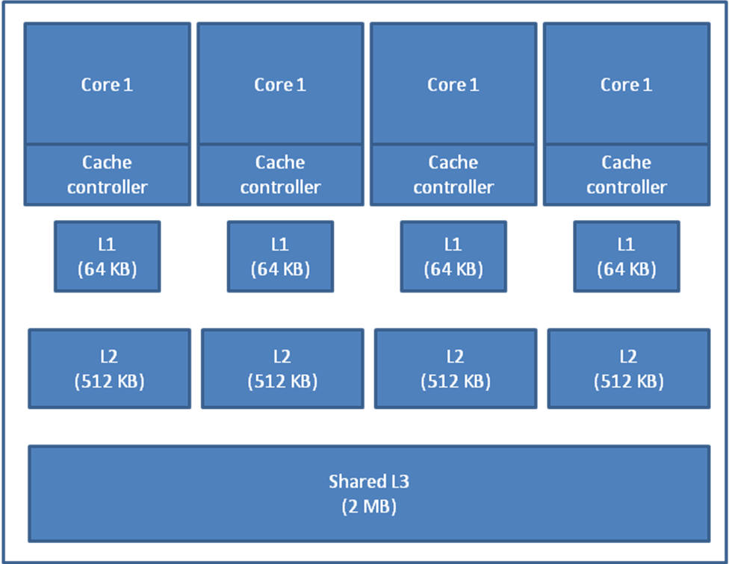
9.24 Memory hierarchy of modern processors – An example

Slide 87
Questions?

